Slide 1
Project scheduling
It involves deciding which tasks would be taken up when. Activities undertaken:
1. Identify all the tasks needed to complete the project.
2. Break down large tasks into small activities.
3. Determine the dependency among different activities.
4. Establish the most likely estimates for the time durations necessary to complete the activities.
5. Allocate resources to activities.
6. Plan the starting and ending dates for various activities.
7. Determine the critical path. A critical path is the chain of activities that determines the duration of the project.

Slide 2
Work breakdown structure
Work Breakdown Structure (WBS) is used to decompose a given task set recursively into small activities.
The root of the tree is labeled by the problem name.
Each node of the tree is broken down into smaller activities that are made the children of the node.
Each activity is recursively decomposed into smaller sub-activities until at the leaf level, the activities requires approximately two weeks to develop.

Slide 3
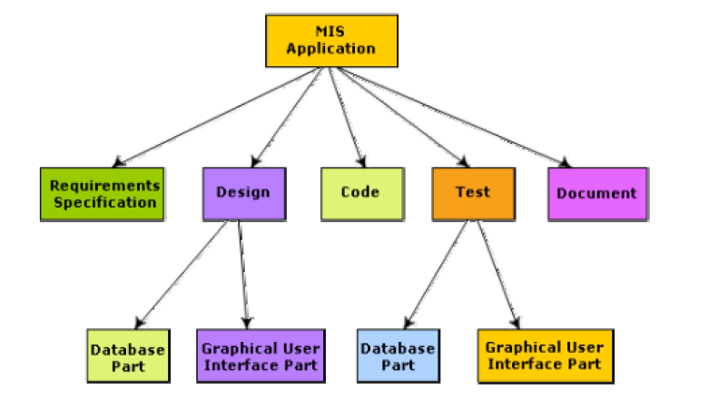
Work breakdown structure of MIS problem

Slide 4
Activity networks and critical path method
WBS representation of a project is transformed into an activity network by representing activities identified in WBS along with their interdependencies.
An activity network shows the different activities making up a project, their estimated durations, and interdependencies.

Slide 5
Slack Time
The slack time (or float time) is the total time that a task may be delayed before it will affect the end time of the project.
The slack time indicates the “flexibility” in starting and completion of tasks.
A critical task is one with a zero slack time. A path from the start node to the finish node containing only critical tasks is called a critical path.

Slide 6
Q. Activity network shows which of the following activities?
Efforts
Staffing
Duration
All of the above

Slide 7
Critical Path
Task dependencies define a partial ordering among tasks, i.e.
  Completion of some tasks must precede the starting time of some other tasks.
A critical path:
  along which every milestone is critical to meeting the project deadline.
A Critical Path is a chain of tasks that determine the duration of the project.

Slide 8
Critical Paths
A critical paths is sequence of tasks such that
  a delay in any of the tasks will cause a delay to the entire project.
There can be more than one critical path in a project.
It is important for the project manager to be aware of the critical paths in a project:
  can ensure that tasks on these paths are completed on time.

Slide 9
Critical Paths
Other tasks may have some room for delay without affecting the entire project.
  If necessary, the manager may switch resources from a noncritical task to a critical task.
Several software packages are available for automating the scheduling process:
  MacProject on Apple Macintosh computer
  MS-Project on Microsoft Windows Operating System.

Slide 10
CPM and PERT Charts
While Gantt charts show the different tasks and their durations clearly:
  they do not show intertask dependencies explicitly.
  this shortcoming of Gantt charts is overcome by PERT charts.

Slide 11
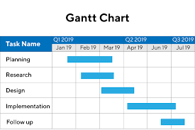


Slide 12
Critical Path Management
Critical Path Management(CPM) is a technique for:
  Identifying critical paths
  Managing project.
The CPM technique is not specific to software engineering
  has a much wider use.

Slide 13
Critical Path Management
CPM can assist in answering questions like:
  What are the critical paths in the project?
  What is the shortest time in which the project can be completed?
  What is the earliest (or latest) time a task can be started (or finished) without delaying the project?

Slide 14
Example
A project involves three tasks:
  task a takes 4 hours,
  task b takes 5 hours
  task c takes 8 hours.
  task c cannot commence until task a is completed.
What is the shortest time in which the project can be completed?
b
5
finish
start
4
a
c
8

Slide 15
Example
Clearly, the project continues until task a and then task c complete:
  which is 12 hours.
  Task b takes only 5 hours.
  Task b can have 7 hours of leeway to start and finish.
b
5
finish
start
4
a
c
8

Slide 16
What data do we need to construct a CPM graph?
To construct a CPM graph,
  a list of tasks and their durations are required.
  Also, for each task a list of tasks upon which it depends is required.
  A task may depend on more than one task.
Project task details can be given in the form of a table.

Slide 17
Task Table
Task | Duration | Predecessor
Start |  | a,b,g
a | 10
b | 20
c | 20 | a,g
d | 5 | b
e | 10 | b
f | 5 | d,e
g | 5

Slide 18
CPM Graph
c:20
a:10
start
finish
g:5
b:20
f:5
d:10
e:10

Slide 19
How do we work out the various start and finish times for tasks?
Minimum time to complete project (MT) = Maximum of all paths from start to finish
Earliest start time (ES) of a task = Maximum of all paths from start to this task
Earliest finish time (EF) of a task = ES + duration of the task
Latest finish time (LF) of a task = MT - Maximum of all paths from this task to finish
Slack time = LS - ES = LF - EF

Slide 20
CPM graph Example
Activity | Predecessor | Duration (in months)
A | - | 5
B | A | 4
C | A | 5
D | B | 6
E | C | 3
F | D,E | 4

Slide 21
CPM graph
B
D
Start
F
Finish
A
C
E

Slide 22
Critical Path Calculation
ES | MT (D) | EF
 | Activity
LS | SL | LF
ES : Earliest start time
MT(D): Maximum Time/Duration
EF : Earliest Finish Time
LS: Latest Start Time
SL: Slack Time
LF: Latest Finish Time
Activity : Critical activity of the project.
Formulae:
EF = ES + D
SL = LF – EF
LS = LF – MT (D)
ES = Predecessor’s EF
LF = successor’s LS

Slide 23
0 | 5 | 5
 | A
5 | 4 | 9
 | B
5 | 5 | 10
 | C
9 | 6 | 15
 | D
10 | 3 | 13
 | E
15 | 4 | 19
 | F

Slide 24
SL = LF – EF
LS = LF – D
Start calculation from the finish (last) activity = F
15 | 4 | 19
 | F
15 | 0 | 19
10 | 3 | 13
 | E
12 | 2 | 15
9 | 6 | 15
 | D
9 | 0 | 15
5 | 5 | 10
 | C
7 | 2 | 12
5 | 4 | 9
 | B
5 | 0 | 9
0 | 5 | 5
 | A
0 | 0 | 5

Slide 25
Critical Paths
From the given example, we have 2 paths:
A->B->D->F
A->C->E->F
B
D
Start
F
Finish
A
C
E

Slide 26
Critical Paths contd
However, a critical path is the one which has 0 Slack Time (SL)
Therefore, out of the two paths,
A->B->D->F path has 0 slack time.
0 | 5 | 5
 | A
0 | 0 | 5
5 | 4 | 9
 | B
5 | 0 | 9
9 | 6 | 15
 | D
9 | 0 | 15
15 | 4 | 19
 | F
15 | 0 | 19

Slide 27
CPM Table:
Activity | ES | MT (D) | EF | LS | SL | LF
A | 0 | 5 | 5 | 0 | 0 | 5
B | 5 | 4 | 9 | 5 | 0 | 9
C | 5 | 5 | 10 | 7 | 2 | 12
D | 9 | 6 | 15 | 9 | 0 | 15
E | 10 | 3 | 13 | 12 | 2 | 15
F | 15 | 4 | 19 | 15 | 0 | 19

Slide 28
Example: Find ES,EF, MT (D),LS,SL,LF and critical path
Task | Duration | Predecessor
Start |  | a,b,g
a | 10
b | 20
c | 20 | a,g
d | 5 | b
e | 10 | b
f | 5 | d,e
g | 5

Slide 29
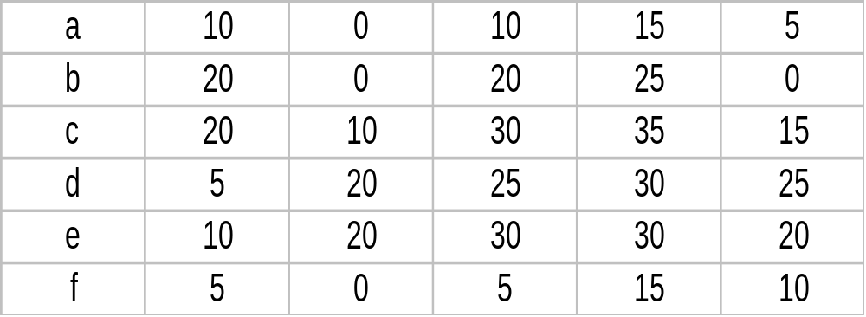
Solution
Task MT(D) EF ES LF LS
SL

Slide 30
Gantt chart
Used to allocate resources to activities (resource planning).
The resources allocated to activities include staff, hardware, and software.
A Gantt chart is a special type of bar chart where each bar represents an activity.
The bars are drawn along a time line.
The length of each bar is proportional to the duration of time planned for the corresponding activity.

Slide 31
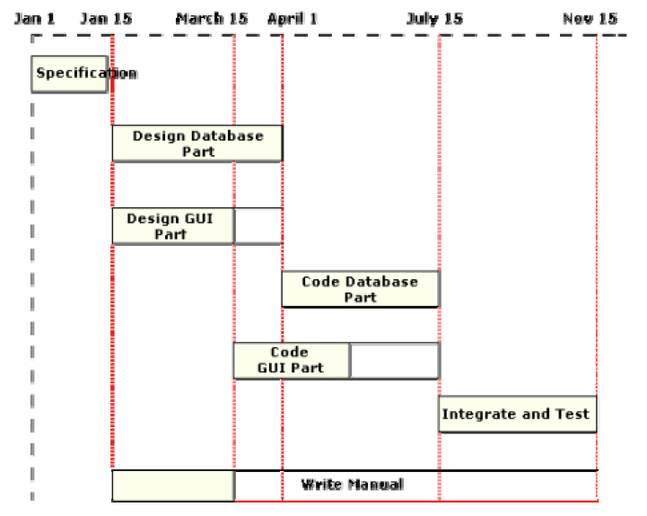
Gantt chart for MIS problem

Slide 32
What is PERT and how does it work?
PERT (Program Evaluation and Review Technique) is a variation of CPM:
  incorporates uncertainty about duration of tasks.
Gantt charts can be derived automatically from PERT charts.
Gantt chart representation of schedule is helpful in planning the utilization of resources,
  while PERT chart is more useful for monitoring the timely progress of activities.

Slide 33
PERT chart
PERT (Program Evaluation and Review Technique) charts consist of a network of boxes and arrows.
The boxes represent activities and the arrows represent task dependencies.
The boxes of PERT charts are usually annotated with the pessimistic, likely, and optimistic estimates for every task.

Slide 34
Gantt chart representation of a project schedule is helpful in planning the utilization of resources, while PERT chart is useful for monitoring the timely progress of activities.
Also, it is easier to identify parallel activities in a project using a PERT chart.

Slide 35
Three estimates of PERT
Each task in a project is annotated with three estimates while making a PERT chart.
1. Optimistic (O): Best possible case task completion time.
2. Most likely Estimate (M): Most likely task completion time.
3. Worst Case (W): The worst possible case task completion time.

Slide 36
Mean estimated time (PERT)
The mean estimated time can be calculated as:
Et = (O +4M+W)/6

Slide 37
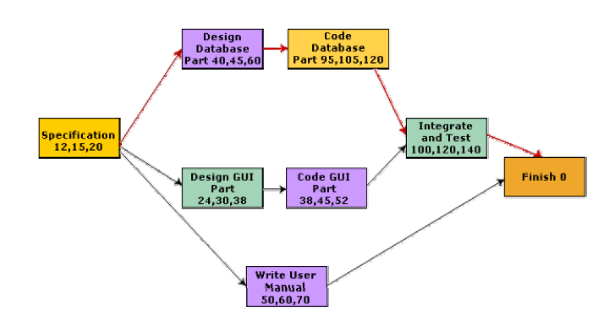
PERT chart representation of the MIS problem

Slide 38
Q. Find out the mean estimated time of the aforementioned PERT chart.

Slide 39
Software Configuration Management
The results (aka deliverables) of any large software development effort consists of a large number of objects:
  source code,
  design document,
  SRS document,
  test document,
  project plan (SPMP) document, etc.

Slide 40
Software Configuration Management (CONT.)
A configuration is a collection of deliverables:
  being developed for some customer.
As development proceeds,
  the components comprising a configuration undergo changes:
  Even during maintenance, the components comprising a configuration keep changing.

Slide 41
What is configuration management?
The set of activities through which the configuration items are managed and maintained
  as the product undergoes its life cycle phases.

Slide 42
Versions
A configuration for a particular system is called a version:
  The initial delivery might consist of several versions,
  more versions might be added later on.
  For example, one version of a mathematical package might run on a Unix machine,
    another on Windows NT, and
    another on Solaris.

Slide 43
Versions
As a software is released and used by the customers:
  errors are discovered,
  enhancements to the functionalities might be needed.
A new release of the software is an improved system intended to replace an old one.
Usually a product is described as version m and release n (or as version m.n)

Slide 44
Software Configuration Management
Existence of variants of a software product causes several problems.
Suppose you have several versions of the same module, and
  find a bug in one of them.
  it has to be fixed in all versions.

Slide 45
Software Configuration Management
Different objects are accessed and modified by a number of engineers.
Unless strict discipline is enforced:
  regarding updation and storage of the objects through some automated tool,
  several problems appear.

Slide 46
Software Configuration Management
For example, an engineer might update the module that he has designed ---
  without informing the engineers who need to interface with this module.
Or, two engineers may simultaneously carry out changes to different portions of a module:
  while saving overwrite each other.

Slide 47
Why Configuration Management?
To be able to identify the exact state of different deliverables at any time.
To avoid the problems associated with having replicated objects accessible by multiple engineers.
Controlling concurrent work on a module by different engineers. (Overwriting one engineer’s work by another)
Letting different engineers work on related modules at the same time.
Keeping track of variants (versions) and helping fix bugs in them.
Storing versions and revisions efficiently.
Maintaining revision history (accounting).

Slide 48
Software Configuration Management
Configuration management helps to:
  quickly determine the current state of the product
  change the various components (modifications, revisions, variations etc.) in a controlled manner.
  maintaining the current up-to-date status of various versions of the software,
  control and account changes to the product.

Slide 49
In short
Inconsistency problem when the objects are replicated-changes to local copy bt not informing
Problems associated with concurrent access
Providing a stable development environment-A integrates , B and C changes –cont,etc
System accounting and maintaining status information
Handling variants

Slide 50
Baseline
A baseline is the status of all the objects under configuration control. When any of the objects under c control is changed, a new baseline gets formed.
It may be archived periodically(copying to a safe place) so that the last baseline can be recovered in case of disaster.

Slide 51
Software Configuration Management Activities
Configuration management is carried out through three principal activities:
  configuration identification,
  configuration control,
  configuration accounting and reporting.

Slide 52
Software Configuration Management Activities
Configuration identification
  which parts of the system must be kept track of?
Configuration control
  ensures that changes to a component happen smoothly.
Configuration accounting
  keeps track of what has been changed, when, and why.

Slide 53
Configuration Identification
Deliverable objects can be classified into three main categories:
  controlled,
  precontrolled,
  uncontrolled.
Controlled objects are under configuration control:
  you must follow some formal procedures to change them.

Slide 54
Configuration Identification
Precontrolled objects are not yet under configuration control,
  but may eventually be under configuration control.
Uncontrolled objects are not and will not be subject to configuration control.

Slide 55
Configuration Identification
Typical controllable objects include:
  Design documents
  Tools used to build the system, such as compilers, linkers, lexical analyzers, parsers, etc.
  Source code for each module
  Test cases
  Problem reports

Slide 56
Configuration Control
Configuration control is the process of managing changes.
  It is the part of configuration management that most directly affects day-to-day operations of the developers.
Once an object goes under configuration control,
  any further changes requires approval from a change control board (CCB).

Slide 57
Configuration Control
The CCB is constituted from among the development team members.
For every change carried out,
  CCB certifies several things about the change:
    Change is well-motivated.
    Developer has considered and documented the effects of change.
    Appropriate people have validated the change.

Slide 58
Configuration Control
An important reason for configuration control:
  people need a stable environment to develop a software product.
Suppose you are trying to integrate module A, with the modules B and C,
  you cannot make progress if developer of module C keeps changing it;
  this is especially frustrating if a change to module C forces you to recompile A.
As soon as a document under configuration control is updated,
  the updated version is frozen and is called a baseline.

Slide 59
Configuration Control
Baseline
New Baseline
A
B
A
B
C
D
C’
D
Reserve
Replace
Cancel Reservation
C
Private Copy

Slide 60
Configuration Control
This establishes a baseline for others to use.
Freezing a configuration may involve archiving everything needed to rebuild it.
  Archiving means copying to a safe place such as a magnetic tape.
At any given time, a programmer may pay attention to:
  Current baseline configuration
  Programmer's private version

Slide 61
SCCS (Source Code Control System)
SCCS is a configuration management tool:
  available on Unix systems:
  helps control and manage text files.
  also implements an efficient way of storing versions:
    minimizes the amount of occupied disk space.

Slide 62
SCCS
Suppose a module is present in 3 versions:
  MOD1.1, MOD1.2, and MOD1.3.
SCCS stores the original module MOD1.1
  together with changes needed to transform it into MOD1.2 and MOD1.3.
  the modifications are called deltas.

Slide 63
SCCS Features
Access control facilities provided by SCCS include:
  facilities for checking components in and out.
  Individual developers check out components and modify them.
    after they have changed a module as required and the module has been successfully tested,
    they check in the changed module into SCCS.

Slide 64
SCCS Features
Revisions are denoted by numbers in ascending order,
  e.g, 1.1, 1.2, 1.3 etc.
It is also possible to create variants of a component
  by creating a fork in the development history.

Slide 65
Summary
Project staffing requires careful understanding of the attributes of good software engineers.
Project scheduling:
  break down large tasks into smaller logical units,
  determine dependencies among tasks,
  determine expected duration of tasks,
  assign resources, and
  assign times.

Slide 66
Summary
Several techniques are available to help in scheduling:
  Work breakdown structure
  Activity networks
  Gantt charts
  PERT and CPM
Commercial software tools are available to assist in developing these.

Slide 67
Summary
It is necessary to determine the critical paths in a project:
  to meet the timing for critical activities.
An important project planning activity is risk management:
  Risk identification
  Risk assessment
  Risk containment

Slide 68
Summary
Configuration management.
  the set of activities by which a large number of objects are managed and maintained.

